Slide 1
I211 – Information Infrastructure II
Lecture 14

Slide 2
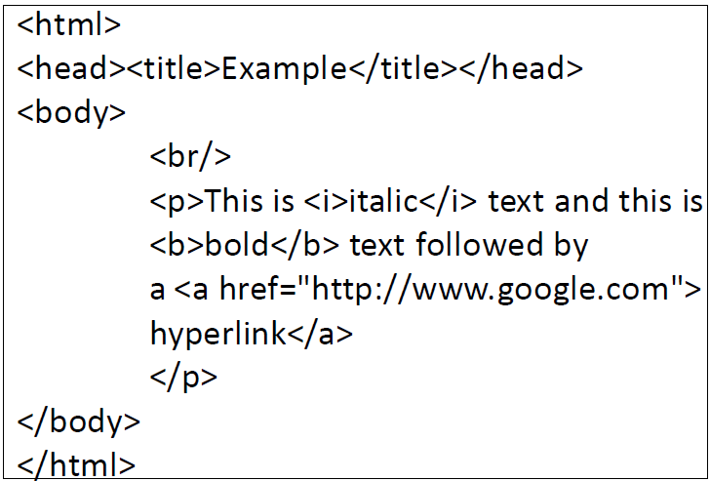
What is HTML?
Hyper Text Markup Language
These days, HTML can be considered a subset of XML that has formatting information built-in.
HTML is NOT a programming language!
Let’s recap some basic tags.

Slide 3
HTML Basics
HTML documents have <html> as their outer container tag.
Inside that, the main containers are <head> and <body>.
<head> can include a <title> for the page.
Open Notepad or Dreamweaver and save this as basics.html :
<html>
<head>
<title>TITLE OF PAGE</title>
</head>
<body>
CONTENT OF PAGE
</body>
</html>

Slide 4
HTML Basics
Bold text: <b></b>
Italicized text: <i></i>
New line: <br /> This is its own closing tag!
<html>
<head>
<title>TITLE OF PAGE</title>
</head>
<body>
<b>BOLD</b>
<br />
<i>ITALIC</i>
</body>
</html>

Slide 5
HTML Basics
Paragraphs: <p></p> Notice the automatic spacing!
<html>
<head>
<title>TITLE OF PAGE</title>
</head>
<body>
<p>Paragraph 1</p>
<p>Paragraph 2</p>
</body>
</html>

Slide 6
HTML Basics
Links: <a href=“URL”>Text for link</a>
<html>
<head>
<title>TITLE OF PAGE</title>
</head>
<body>
<a href="http://www.gooogle.com">This takes you to Google!</a>
</body>
</html>

Slide 7

HTML Tables
Tables are commonly used to display information or for quick layout managing.
The outer container is <table>. Each row is contained in <tr>, and each cell is contained in <td>.
<table>
<tr>
<td>Row 1, Col 1</td>
<td>Row 1, Col 2</td>
</tr>
<tr>
<td>Row 2, Col 1</td>
<td>Row 2, Col 2</td>
</tr>
</table>

Slide 8

HTML Tables
If you want a border, add this!
<table border="1">
<tr>
<td>Row 1, Col 1</td>
<td>Row 1, Col 2</td>
</tr>
<tr>
<td>Row 2, Col 1</td>
<td>Row 2, Col 2</td>
</tr>
</table>
Unlike Python, the indentation is not required. We use it for legibility.

Slide 9
HTML Links
HTML 4 and HTML 5 Tutorial:
http://www.w3schools.com/html/default.asp
HTML Examples:
http://www.w3schools.com/html/html_examples.asp
List of all default elements in HTML 4:
http://htmlhelp.com/reference/html40/olist.html
CSS Reference:
http://htmlhelp.com/reference/css/

Slide 10
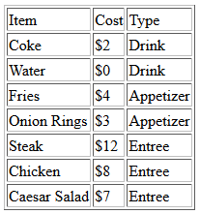
List -> HTML (Group Work)
Write a program that takes a list like this and writes it out as a table in an HTML file:
data = [("Item", "Cost", "Type"), ("Coke", "$2", "Drink"),
("Water", "$0", "Drink"), ("Fries", "$4", "Appetizer"),
("Onion Rings", "$3", "Appetizer"), ("Steak", "$12", "Entree"),
("Chicken", "$8", "Entree"), ("Caesar Salad", "$7", "Entree")]

Slide 11
List -> HTML(Solution)
data = [("Item", "Cost", "Type"), ("Coke", "$2", "Drink"),
("Water", "$0", "Drink"), ("Fries", "$4", "Appetizer"),
("Onion Rings", "$3", "Appetizer"), ("Steak", "$12", "Entree"),
("Chicken", "$8", "Entree"), ("Caesar Salad", "$7", "Entree")]
print data
out = open("html_table.html", "w")
out.write("<html><body><table border='1'>")
for sublist in data:
out.write("<tr>")
for elem in sublist:
out.write("<td>" + str(elem) + "</td>")
out.write("</tr>")
out.write("</table></body></html>")
out.close()
print "Finished writing."
<html><body><table border='1'><tr> <td>Item</td> <td>Cost</td><td>Type</td></tr><tr><td>Coke</td> <td>$2</td><td>Drink</td></tr><tr><td>Water</td>
<td>$0</td><td>Drink</td></tr><tr><td>Fries</td>
<td>$4</td><td>Appetizer</td></tr><tr><td>Onion Rings</td><td>$3</td><td>Appetizer</td></tr><tr>
<td>Steak</td><td>$12</td><td>Entree</td></tr>
<tr><td>Chicken</td><td>$8</td><td>Entree</td>
</tr><tr><td>Caesar Salad</td><td>$7</td><td>
Entrée</td></tr></table></body></html>

Slide 12
HTML -> List (Group Work)
Assume you have a table in an HTML file:
Write a program that reads the HTML file and creates a list of lists corresponding to the table. Print the list.
BONUS: (1pt) Use list comprehensions to do the work.
Data loaded from file:
[['Item', 'Cost', 'Type'], ['Coke', '$2', 'Drink'], ['Water', '$0', 'Drink'], ['Fries', '$4', 'Appetizer'], ['Onion Rings', '$3', 'Appetizer'], ['Steak', '$12', 'Entree'], ['Chicken', '$8', 'Entree'], ['Caesar Salad', '$7', 'Entree']]

Slide 13
HTML -> List (Solution 1)
in_file = open("html_table.html", "r")
data = in_file.read().split("<") #break up into tag chunks
in_file.close()
my_list = []
for item in data:
if "tr>" in item and "/tr>" not in item: #start of a row
sublist = []
elif "td>" in item and "/td>" not in item: #start of a data cell
sublist.append(item[3:])
elif "/tr>" in item: #end of a row
my_list.append(sublist)
print "Data loaded from file:\n", my_list

Slide 14
HTML -> List (Solution 2)
import xml.etree.ElementTree as ET
#we can treat an HTML document as XML!
root = ET.parse(source="html_table.html")
rows = root.findall("body/table/tr")
my_list = []
for elem in rows: #walk through the rows
sublist = []
cells = elem.findall("td") #find all the cells
for cell in cells:
sublist.append(cell.text)
my_list.append(sublist) #build the list
print "Data loaded from file:\n", my_list

Slide 15
HTML -> List (Solution w/ Bonus)
import xml.etree.ElementTree as ET
root = ET.parse(source="html_table.html")
#nested list comprehension
my_list = [[cell.text for cell in item.findall("td")] for item in root.findall("body/table/tr")]
print "Data loaded from file:\n", my_list

Slide 16
HTML and CGI
Common Gateway Interface
An interface to pass web requests off to an executable program and return results to a browser
The Yahoo finance page and the Boston Market locator were both CGI scripts.
CGI scripts can be written in many different scripting languages.

Slide 17
CGI Setup
Due to recent changes, having a burrow account is now sufficient for using the CGI server.
(In previous semesters students also created "sharks" accounts)
In order to run cgi scripts, you will need to log in to your burrows account (see Lecture 6):
Run the "make-cgi" script and answer 'y' to each question. Alternatively, you can just run "make-cgi -y" and it will automatically answer yes to each question.

Slide 18
CGI Setup
This will enable you to upload CGI scripts to your burrows account (in a folder called cgi-pub) and run them from a URL:
https://cgi.soic.indiana.edu/~yourusername/

Slide 19
HTML and CGI
Remember how we made a .py file executable?
First line of a Python CGI script needs to be: #! /usr/bin/env python
This tells the server that this is a Python CGI script, as opposed to one in some other language.

Slide 20
CGI Hello World hello.cgi
Save this file as hello.cgi:
#! /usr/bin/env python
print 'Content-type: text/html\n' #necessary for it to work!
print '<html><head><title>First CGI</title></head>'
print 'Hello World!<br>'
print '</html>'
You’ll need to copy the file into your cgi-pub directory on Burrow and then change the rights on it to be executable by running this command: chmod 755 hello.cgi
https://cgi.soic.indiana.edu/~yourusername/hello.cgi

Slide 21
HTML and CGI
Content-type: text/html
This tells the browser to expect HTML, as opposed to some other form of data.
You can see a list of content types here: http://en.wikipedia.org/wiki/Internet_media_type#List_of_common_media_types
These are called MIME types.
The \n at the end of the MIME type line is needed to tell the browser that the actual content begins there!

Slide 22
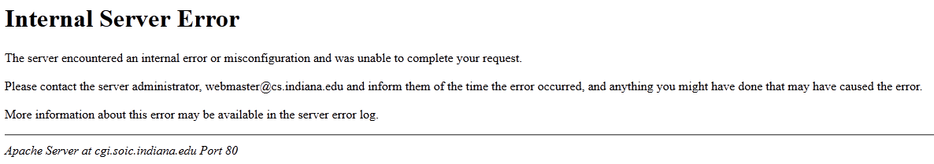
Whoops?
If you try to run invalid code, you’ll see this:
This is an unhelpful error since it doesn’t tell us what happened.
This will sometimes reset the permissions on the file, so you may have to chmod 755 it again

Slide 23
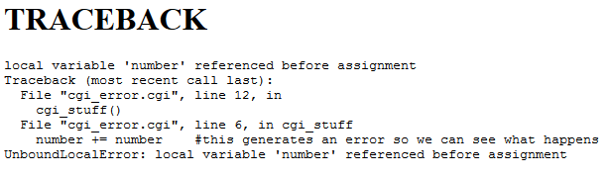
Errors in HTML and CGI error.cgi
#! /usr/bin/env python
print 'Content-type: text/html\n'
def cgi_stuff():
number += number #this generates an error so we can see what happens
print "We won't get here."
try:
import traceback, sys, os, cgi
sys.stderr = sys.stdout
cgi_stuff()
except Exception, e:
print '<html><head><title>Error in Script</title></head><body>'
print '<h1>TRACEBACK</h1>'
print '<pre>'
print str(e)
traceback.print_exc()
print '</pre>'
print '</body></html>'

Slide 24
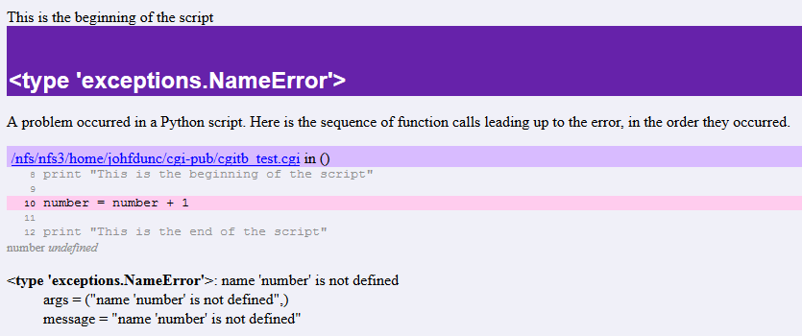
Errors in HTML and CGI error2.cgi
#! /usr/bin/env python
import cgitb # special 'traceback' module for outputting error info
cgitb.enable() # you will want to remove this when your script is debugged
print 'Content-type: text/html\n'
print "This is the beginning of the script"
number = number + 1 # error
print "This is the end of the script"

Slide 25
Second Script fancy.cgi
Download python.png from Oncourse and try this:
#! /usr/bin/env python
print 'Content-type: text/html\n'
text = """
<html>
<head><title>A Second CGI Script</title></head>
<body>
<h1>A Second CGI Script</h1>
<p>Hello, CGI World!</p>
<img src="python.png" border="1" alt="Python Logo">
<hr>
</body>
</html>
"""
print text
Don’t forget to upload both files to your cgi-pub and chmod 755 fancy.cgi !
If it doesn’t work, try using pico to edit the file, make a small change, then save it.

Slide 26
Questions?

